Slide 1

GAMING PLAYER MATCHING APP
By Team 6 MNL
001

Slide 2
THE GPM
001
002
003
004
005
006
Problem Definition & Solution
Market Research
Business Model
Algorithms
Challenges
Q&A

Slide 3
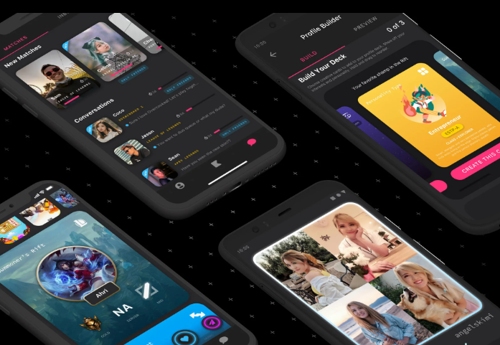
Why do we need GPM?
For Users:
Who struggle to find teammates
Specifically Mobile Gamers
Improve engagement from light to deep
Social networking (Dating)
Online Streamer
For Gaming Companies:
Increase Daily Avg Online Time
Attract new players
Improve gaming experience
Gain more revenue
Notes:
Jacky
Gaming player matching app
What is GPM, It is an app that can better assist game players to find gaming partner and also serve as a social networking software, it is like tinder but specially designed for gamers to find game team or same rank level partner. For Gaming companies side it will help company increase daily avg.online time, attract new users → make more profit.
For players(dating, online streamers): Find friends with same interest, find partners with similar level of game playing skills(rank), personal characteristic, types of games, times of the day they play
For Gaming companies: increase daily avg.online time, reduce customer churn, attract new users → profit and revenue improvement
Mia will share to you guys market research we made.
What is the problem we want to solve?
According to research and our own gaming experience, we often found that it is more important for the gamer to play with friends and not how much fun the game is. And there are platforms especially in china, we can see players and online streamer paying people online to play with them. And people often care who they play with and not care about the game itself, especially in mobile games. And our app here solve the problem of finding the perfect gaming companion for the player and at the same time serve as a social networking software.
Focus on customers
are gamers who cannot find others to play with
MOBILE gamers!
Turn Light gamers into addictive gamers with the help of finding the people they want to play with and at the same time make them connect deeper with games.
Males who is only looking for females to play with, vice verus(younger generations)
People who has high rank try to find a low rank player and vice verus

Slide 4
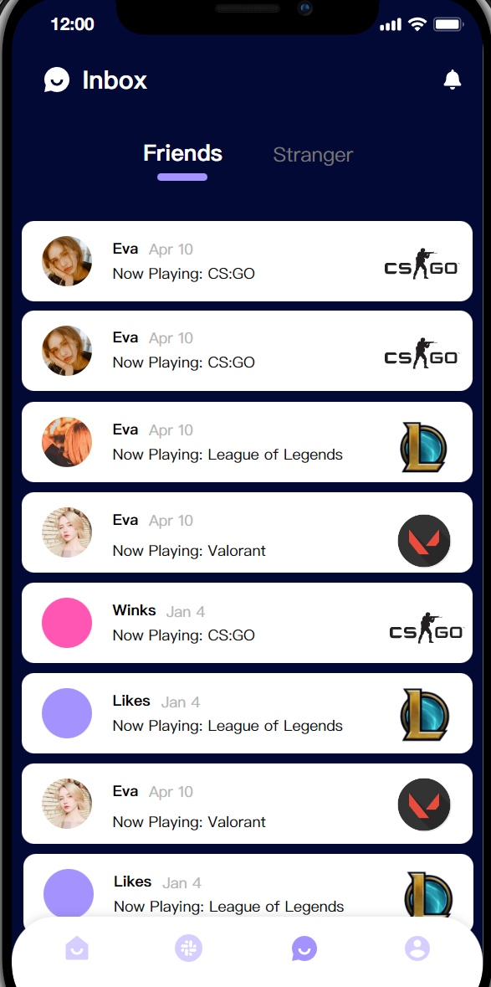
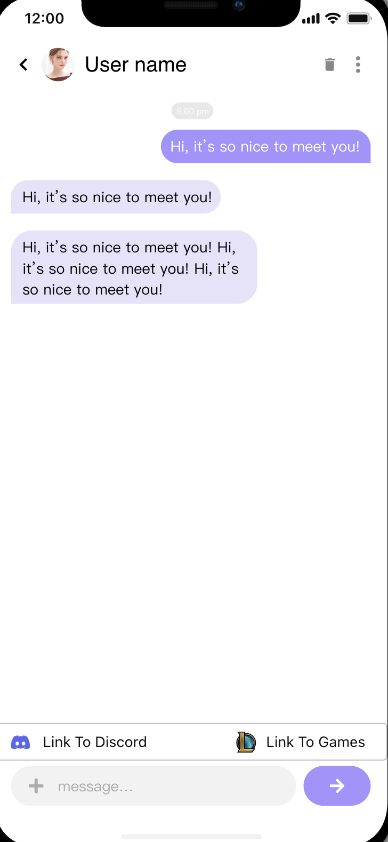
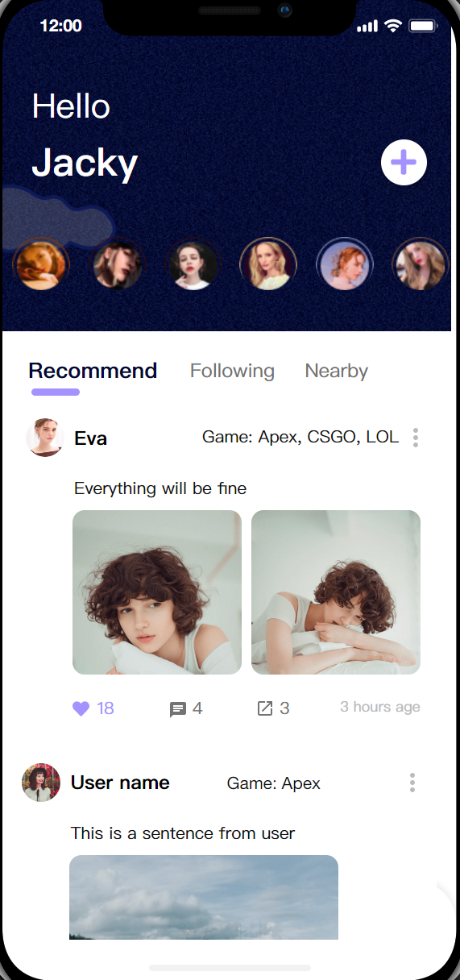
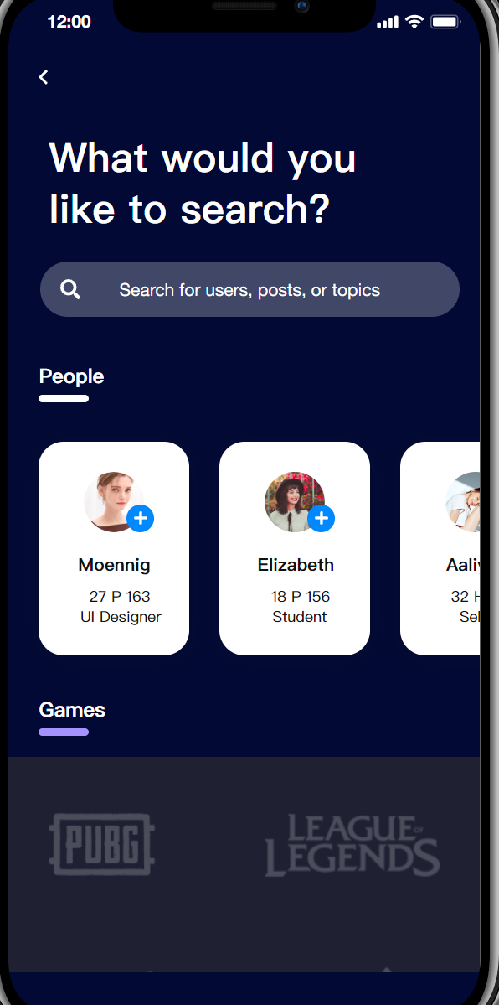
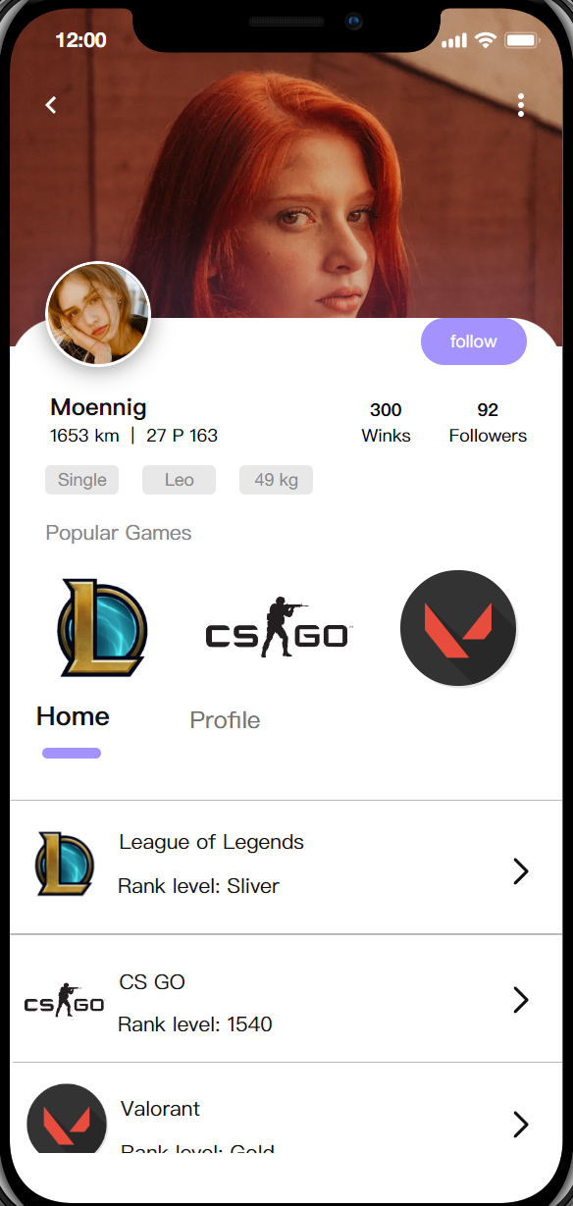
PRODUCT DEMO
Notes:
Jacky

Slide 5
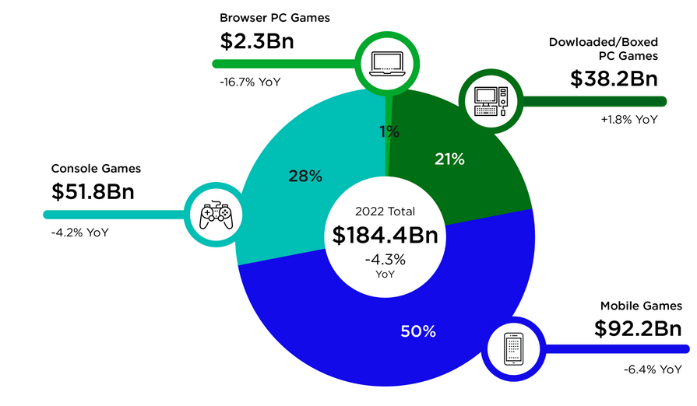





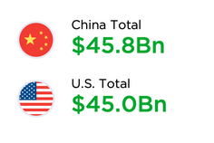


MARKET RESEARCH
Global growth of the game industry.
Game companion services segment
China:market value 13.8 billion yuan
(~ $2 billion)
U.S. $293 million
Immense potential of game companion market!
Notes:
The gaming industry is growing rapidly on a global scale, the online gaming market is valued at hundreds of billion dollars as of 2022, with China and the United States leading the market with similar market value.
As the gaming industry expands, there is a growing demand particularly in the game companion services segment. Casual gamers seek individuals to play with, more professional gamers aspire develop game into a career, and some skilled players offer these services to earn a part-time or full-time income.
In 2020, the market value of chinese gaming companion market is about 2 billion dollars, one of the most popular game companion platform, Bixin, has over 40 million users, In addition, some game streamers offer companion services through live streaming platforms, such as Douyu, Huya, and Panda TV. and there are also other gamer social media platforms like YY,
in the United States, however, though the overall gaming market value is similar to China, the gaming companion market is still to be explored, the market size is about 7 times smaller, and there are companies such as Gamer Sensei, Boosting Factory, and Elo Boost Pros operate in this industry.
The potential of growth in the game accompaniment industry is promising, especially in the United States, and our GPM app is going to enter this market

Slide 6
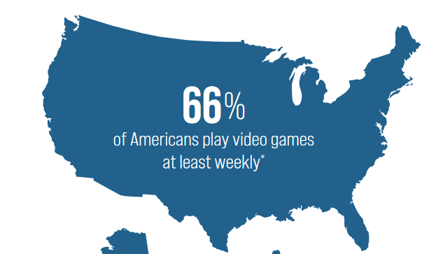
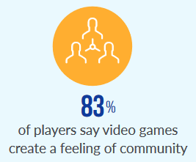
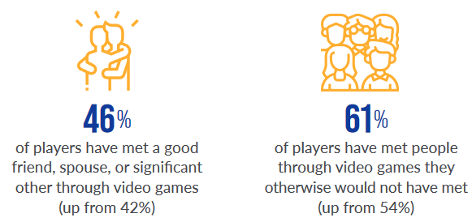
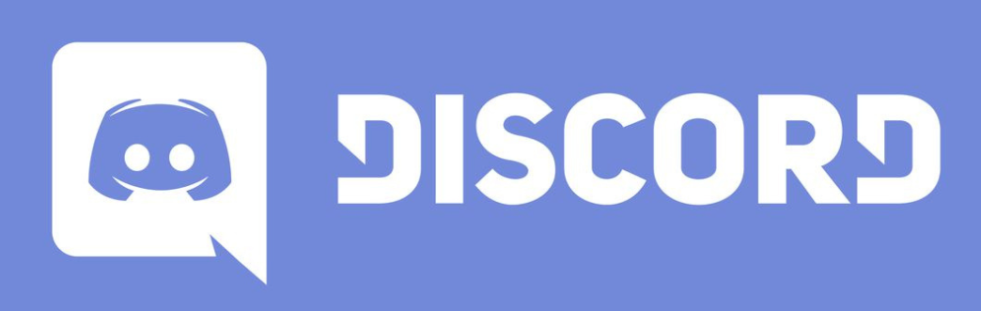

Target Customer
01
02
03
Players
seek social interaction in gaming
- Influencers to play video games and create a full-time income
Isolated experience → burnout and decreased motivation
Collaboration → share the workload, inspire ideas, and provide support and feedback
Current approaches: Browse Channels, etc.
- Major premium publishers (EA, Activision-Blizzard, and Take-Two) generated 57% of revenue through in-game transactions, more than PC and console game sales
Matchmaking drive long term engagement in multiplayer games.
Online Streamers
collaborate with others to boost creativity
Companies
increase user engagement and revenue
Notes:
Same as we pred last time, the target customers of our GPM app are the players, online streamers and game companies.
For the players, GPM can fulfill more potential needs of social interaction.
For online influencers GPM can provide more reliable matches based on algorithms to help them build collaborations;
And for Game companies, matchmaking can increase players’ long-term engagement and in-game transactions

Slide 7
Business Model
Goal: efficiently and precisely connect gamers for online gameplay
Making Profit
Benefits
personalized gaming experience
increased engagement and satisfaction
addresses the issue of gamers struggling to find appropriate teammates
Reduce toxic behaviors
Subscription-Based
monthly or annual subscription
premium features
Advertising-Based
targeted advertisements to users based on their gaming interests and preferences
Partnership-Based (Gaming platform and companies)
A commission fee for every successful match made
A percentage of the revenue generated by users who benefit from exclusive deals and promotions
KPI
Redirect to game rate
Personality tags or labels
Rating System
Notes:
Our business goal is to develop an app that can efficiently and precisely connect gamers for online game play.
so what are some benefit of our idea and why would users, gaming companies like steam or twitch would pay us,
So the app can provide a personalized gaming experience for users by matching them with gamers they are interested, leading to increased engagement and satisfaction.
addresses the issue of gamers struggling to find appropriate teammates when they want to play
lastly, the app can also help reduce toxic behaviors in online gaming, as players are less likely to show negative behavior towards teammates.
In order to make sure the matching is successful, we will utilize a (KPI) to measure the effectiveness.
redirect to game rate, which indicates the proportion of successful matches that result in players actually starting the game together.
Additionally, we will incorporate personality tags or labels for users to enhance the accuracy of our matching process.
implement a rating system for players, which will provide valuable feedback for us to improve our matching algorithms.
So most importantly how do we make money:
Firstly, the app can implement a subscription-based model. The app can charge a monthly or annual subscription fee for premium features, such as access to advanced user matching algorithms, more personalized recommendations, and additional social networking features.
display targeted advertisements to users based on their gaming interests and preferences. Advertising can providing a source of revenue for the business.
the app can establish strategic partnerships with gaming companies and platforms, and earn a commission fee for every successful match made through the app or receive a percentage of the revenue generated by users who benefit from exclusive deals and promotions offered by gaming companies and platforms.

Slide 8
ALGORITHM
Numerical data & Text (Bio)
-NLP
-Scaling
-Vectorization using Count/TFIDF
-Depend on number of features, conduct PCA,determine the optimal number of features to prepare for clustering
-Clustering : K-Means clustering method
Agglomerative hierarchical clustering
Optimization & Standard criteria:
Resampling & Cluster Stability
Measured by Jaccard’s similarities
002
Notes:
For this part,I listed some feasible machine learning methods that might be used in this app. We will be using k-means clustering for handling numerical data. Possible steps include: scaling data, vectorization using Count or TFIDF, conduct PCA based on number of features. Optimize the total number of features that we would like to include based on the models’ performance and our actual need.(i.e,our initial matching includes different requirements from different users.) Assigning each profile to a cluster, decide how many clusters we would like to include.
We also need to handle text information provided in the profile. A paragraph of self-description would help users describe their hobbies & interests. We will be using NLP to find users that share similar interests. It is also worth investigating pairs of words that occurs together to help us make better accommodations.
Lastly, we would be closely monitoring and detecting the inappropriate text in our communication platform. This can also be done by training the model ahead of time.

Slide 9
Challenges and Possible Approaches
Cooperate with giant game firms
Accuracy of matching system
Value in improving active users
Spillover between games
Constantly attracting new users
Modifying algorithm (Collaborative filtering and Content-based filtering)
Real-time Matching
Delay earnings
Developing daily using habit (turn on notification)
Considering usual online time when matching
Sufficient initial funds
Operational efficiency
Notes:
Here I am going to talk about several challenges we may face and possible solutions:
Firstly, cooperating with large game companies is important, but difficult. so, we need to show our value in improving active users and promoting spillover between games to earn their trust.
Secondly, the accuracy of our matching system may be an issue. During the initial stage, it needs time to gather sufficient data to train and adjust our matching system, which may cause users to lose patience and trust in the app, leading to a high churn rate. Besides, even with larger database, achieving perfect matchings constantly may be difficult, because our algorithm mainly focuses on matching users based on users’ similarity. However, in reality, People may not always be interested in those who share the same interests, instead, they may seek out individuals with different backgrounds, interests, and habits. Thus, it is important to constantly attract new users and modify and update our algorithm by incorporating both Collaborative filtering and Content-based filtering into our recommendation system.
Thirdly, real-time matching is another challenge. If the matched users are not online at same time, the matching will be less meaningful, as users cannot chat and play games together immediately. Encouraging users to develop a habit of using the app, such as requiring them to turn on notifications and considering their usual online time during matching, could help overcome this issue.
Lastly, earning revenue from membership costs and game ads will only occur after we achieve specific milestones and earn recognition from users and game companies. Therefore, ensuring sufficient initial investments and operational efficiency are important.
4.1 One of our primary challenges is to establish partnerships with large game corporations, as this is vital but difficult to accomplish.Partnering with game companies is important for acquiring customer information and enabling access to popular games. However, many giant companies with substantial customer bases may not require cooperation with us to maintain their existing customers or expand their business. Therefore, demonstrating our value in improving active users and promoting spillover between games is key to earning their trust.
4.2 The accuracy of our matching system is another significant challenge. During the initial stage, we will need time to gather sufficient data to train and adjust the matching and recommendation system, which may cause customers to lose patience and trust in the app, leading to a high churn rate. Even at the end of this process, achieving perfect matchings consistently may be difficult. Our algorithm primarily focuses on matching users based on simple similarity, which can lead to less accurate recommendations as the algorithm initially suggests users with the highest similarity score. Moreover, people may not always be interested in connecting with those who share the same interests, and instead may seek out individuals with different backgrounds, interests, and habits. Thus, it is crucial to constantly attract new users and modify our algorithm by incorporating both Collaborative filtering and Content-based filtering into our matching and recommendation system.
4.3 Real-time matching presents another challenging hurdle. Ensuring that matched users are online at the same time is difficult, and if they are not, the matching loses its significance as users cannot chat and play games together regularly. Encouraging users to develop a habit of using the app, such as requiring them to turn on notifications and considering their usual online time during matching, could help overcome this issue.
4.4 Lastly, there is the challenge of delayed earnings. Our business primarily earns revenue from membership costs and game ads, which will only occur after the app has achieved phase-specific milestones, developed a stable and active user base, and earned recognition from individual customers and game companies. Therefore, having sufficient initial investments and funds and ensuring operational efficiency are essential.

Slide 10
REFERENCE
2022 Essential Facts About the Video Game Industry
https://www.theesa.com/resource/2022-essential-facts-about-the-video-game-industry/
How to Find Other Streamers to Play With on Twitch or YouTube
https://www.streamscheme.com/find-the-right-collabs-on-twitch-or-mixer/
Esports drives user engagement — and revenue — for free-to-play games
https://venturebeat.com/esports/esports-drives-user-engagement-and-revenue-for-free-to-play-games/
Gaming companions boost esports industry
https://www.chinadaily.com.cn/a/202010/01/WS5f755109a31024ad0ba7cfd8.html
Newzoo’s Games Market Estimates and Forecasts
https://newzoo.com/insights/articles/the-latest-games-market-size-estimates-and-forecast
How Does a Dating App Handle New Profiles?(Part 1)
https://medium.com/swlh/how-a-dating-app-handles-new-profiles-part-1-d283ab2457c
How Does a Dating App Handle New Profiles?(Part 2)
https://medium.com/swlh/how-a-dating-app-handles-new-profiles-part-2-fca4f13b5205
The Unexpected Dangers of Online Dating [11 Scams To Know]
https://www.aura.com/learn/dangers-of-online-dating
I Made a Dating Algorithm with Machine Learning and AI–Utilizing Unsupervised Machine Learning for a Dating App
https://towardsdatascience.com/dating-algorithms-using-machine-learning-and-ai-814b68ecd75e
Notes:
Q&A
What is the problem we want to solve?
According to research and our own gaming experience, we often found that it is more important for the gamer to play with friends and not how much fun the game is. And there are platforms especially in china, we can see players and online streamer paying people online to play with them. And people often care who they play with and not care about the game itself, especially in mobile games. And our app here solve the problem of finding the perfect gaming companion for the player and at the same time serve as a social networking software.
Where can we find the relevant data sources? What kind of data do we want to collect? What is the training data sources?
We can definitely find some data from the online platform that people pay to find gaming companion, and we can also use data from all the dating apps and gaming companies.
我觉得是 data we collected from users when they first log in, first create an account & data from the linked games profiles.
Why would steam/ twitch want to pay for the app?
provide a personalized gaming experience
addresses the issue of gamers struggling to find appropriate teammates
reduce toxic behaviors
improve the online gaming experience, enhance player engagement and satisfaction.

Slide 11
Any questions?

